Slide 1

E-Commerce and Retail B2B Case Study
This study examines payment delays in B2B transactions, specifically focusing on a sports retail company, Schuster. The aim is to predict delayed payments and enhance resource allocation.
Dikshya Napit
Prakhar Bansal
Prashant Nayak

Slide 2

Problem Identification
1
Payment Delays
2
Resource Waste
Vendors delay payments, causing financial lag.
Employees chase payments, reducing value-added work.
3
Business Impact
Smooth operations are affected by these delays.

Slide 3
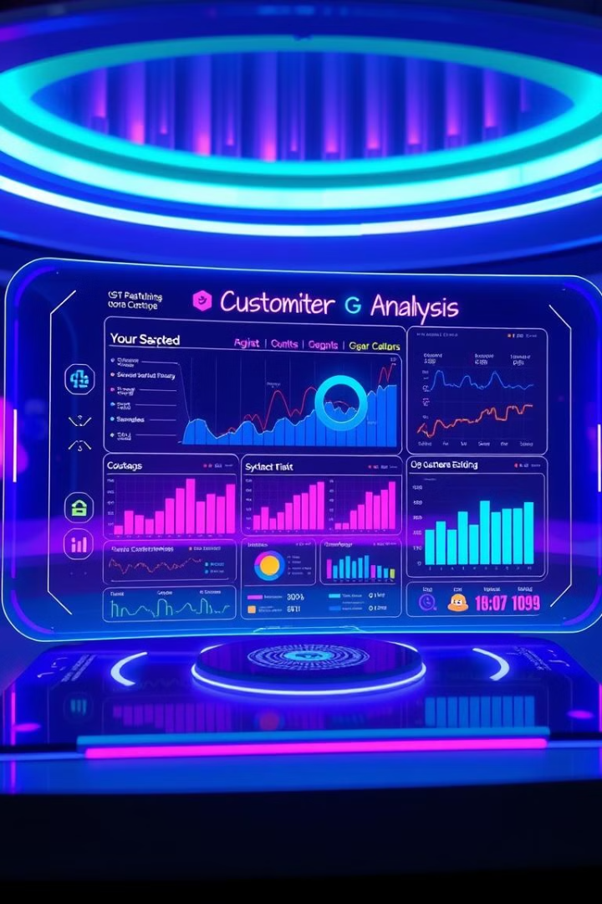



Business Objectives
Customer Segmentation
Payment Prediction
Resource Delegation
Understand customer payment behavior.
Predict delayed payments using historical data.
Improve resource delegation and credit recovery.

Slide 4
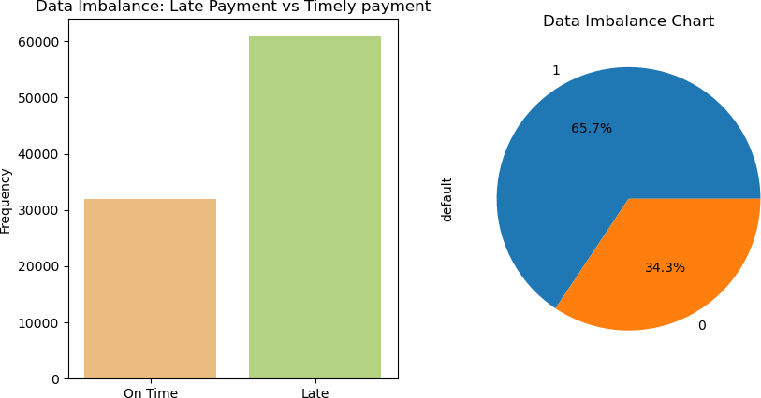
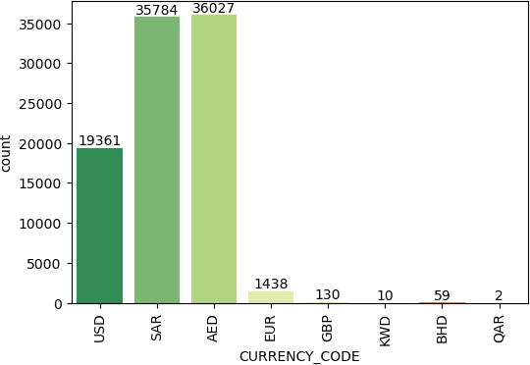
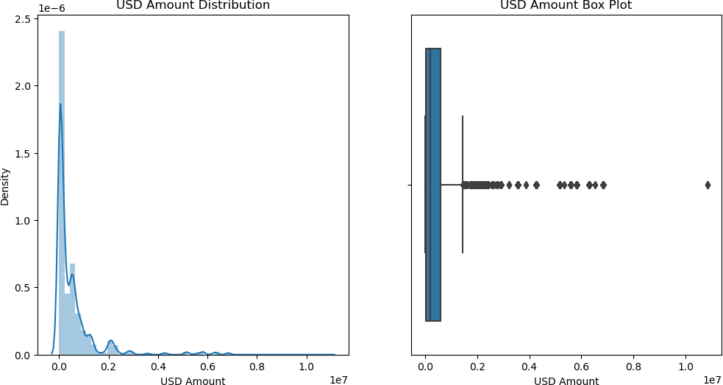
Class Imbalance & Insights
Class Imbalance
Top Currencies
Transaction Values
65.7% towards payment delayers. Acceptable, no treatment needed.
AED, SAR, and USD. AED is the most dealt currency.
Values range between $1 and $3 million.

Slide 5
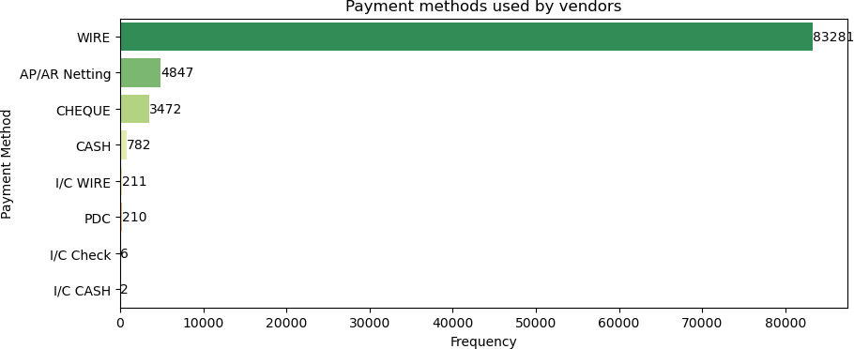
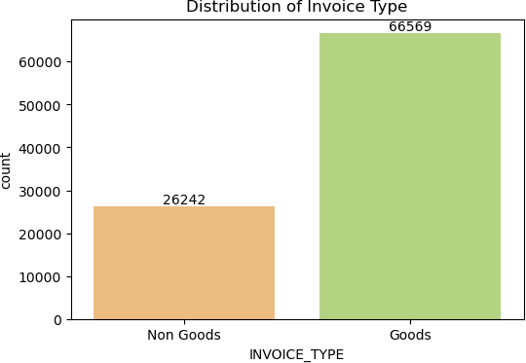
Class imbalance and transaction insights
From Fig. 1, we observe,
Wire payment method is the most common payment method received by the company, followed by netting , cheque and cash
From Fig. 1, we observe,
Wire payment method is the most common payment method received by the company, followed by netting , cheque and cash
From Fig. 1, we observe,
The company primarily receives payments through wire transfers, making it the most frequently used method. Netting is the second most common, with cheque and cash transactions occurring less often.
From Fig. 2
Goods type invoices comprise of the major share of invoices generated

Slide 6
Identifying traits of payment types associated with defaulters

Slide 7
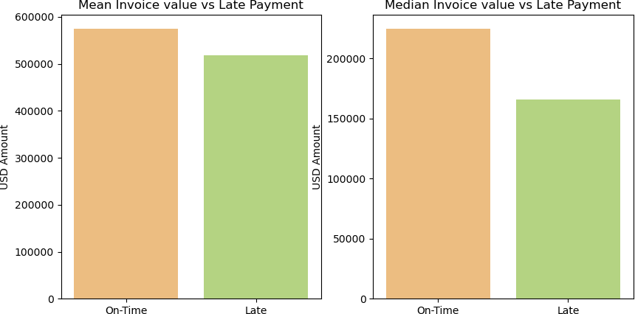
Figure 1
Payers who pay on time have higher mean and median payment amounts, indicating higher-value transactions carry lower delay risk than smaller ones.

Slide 8
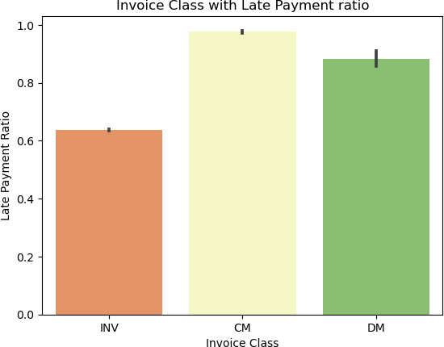
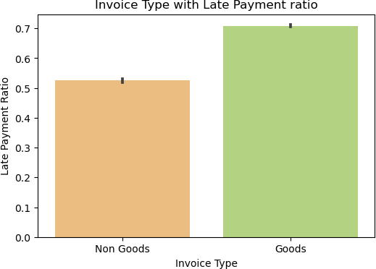
Figure 2
Figure 3
Figure 2 shows the highest late payment ratio for Credit Notes, followed by Debit Notes and Invoices, indicating higher delay risk.
Figure 3 reveals Goods invoices face more delays than non-Goods invoices.

Slide 9
Comparison between two models, logistic regression and random forests

Slide 10
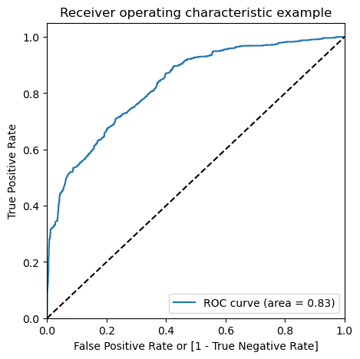
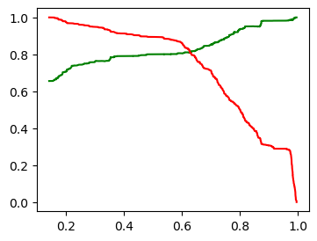
After addressing multicollinearity, the logistic regression model showed good performance with an ROC of 0.83 and an optimal cutoff of 0.6 for predicting payment delays.

Slide 11
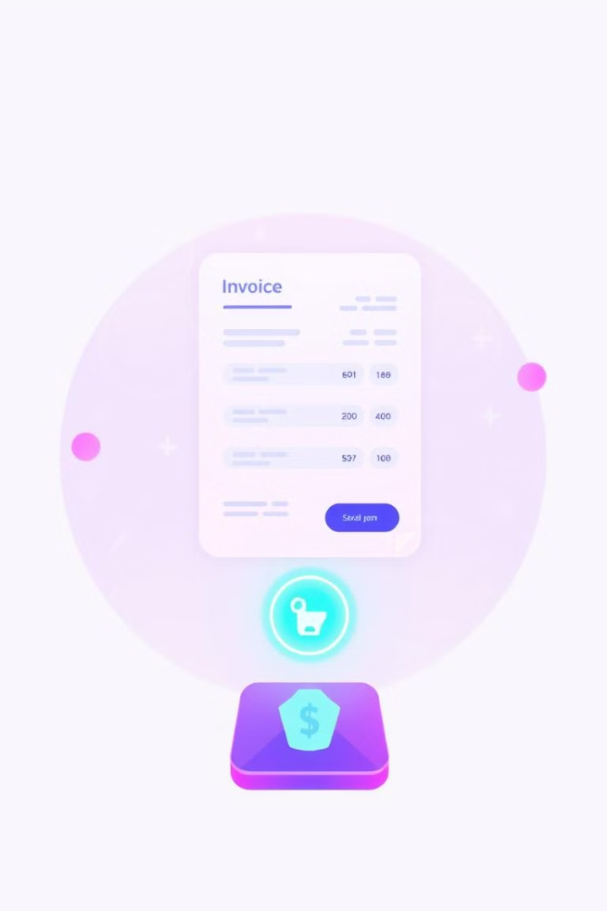
Payment & Invoice Insights
Payment Method
Invoice Type
Wire payment is the most common method.
Goods type invoices comprise the major share.
Invoice Class
The major invoice class is 'Invoice'.

Slide 12



Defaulter Characteristics
Payment Amount
Transaction Type
Invoice Type
Higher value transactions show lesser delay risk.
Credit Note transactions have maximum late payment ratio.
Goods type invoices show greater late payment ratio.

Slide 13



Customer Segmentation
Medium Duration
2
In between the other two.
Early Payers
1
Least average days to pay.
Prolonged Payers
3
Greatest average days to pay.
Prolonged payers have greater delay rates.

Slide 14

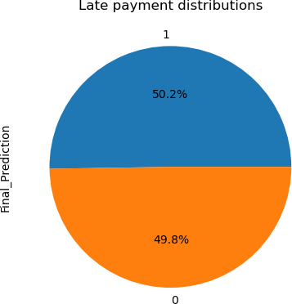
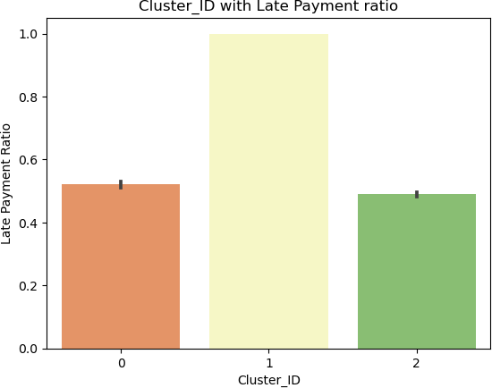
Random Forest Model
Random Forest model was finalized. It had better precision and recall scores. It is better suited for categorical variables.
Predictions suggest 50.2% transactions may be delayed.

Slide 15
Recommendations
Credit Notes face the highest delay rate, so stricter policies are needed.
Goods invoices have higher delay rates, stricter policies are advised.
Focus on lower-value payments due to frequent delays.
Cluster 1 customers need increased focus on payment delays.
Prioritize companies with high delayed payment probability and counts.

Slide 16
Thank you

